Slide 1
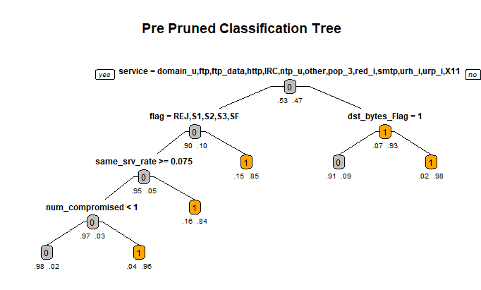
Network Intrusion - Technical Case Study
Business Problem
The dataset consisting of a wide variety of intrusions simulated in a military network environment is to be audited. A connection is established as a sequence of TCP packets starting and ending at some time duration between which data flows to and from a source IP address to a target IP address under some well-defined protocol. Also, each connection is labelled as either normal or as an attack
Problem statement – To identify if the new connection setup is normal or anomalous using Decision Trees and Random Forest
Technical Solution
A modular code is written with sections of Exploratory Data Analysis, Feature Engineering and model Building
For EDA section completely automated codes are written for both Numeric and Categorical Variables dealing with NA, missing and Outlier treatment
Different combinations of methods are tried for feature selection process and its found that fitter method provides better accuracy
For model building section a lot of model enhancement techniques like parameter selection, hyper parameter tuning is performed with proper visualization
Best model found has accuracy of 80.2% and is pre pruned decision tree with max number of levels selected for split are 8 and minimum number of observations per node are 100 using p values and co relation method for feature selection
Benefits
Completely automated and modular codes that can be replicated with proper visualization saving a lot of time and effort
Technology Used
R

